Slide 1

Sql project
BY SIVAKUMAR S

Slide 2


Introducing
This project involves analyzing cricket match data stored across four different databases: batting_summary, bowling_summary, match_summary, and players. Each database contains specific tables with detailed records of batting performances, bowling statistics, match outcomes, and player profiles.

Slide 3
LIST OF CONTENTS
01
08
TOP PARTNERSHIPS
SCORERS IN A MATCH
02
BEST ECONOMY RATES
03
MOST SIXES IN A MATCH
04
MATCH WINNERS BY MARGIN
05
TEAM'S TOTAL RUNS IN A MATCH
06
PLAYERS' ROLES DISTRIBUTION
07
MAIDEN OVERS BY BOWLERS

Slide 4


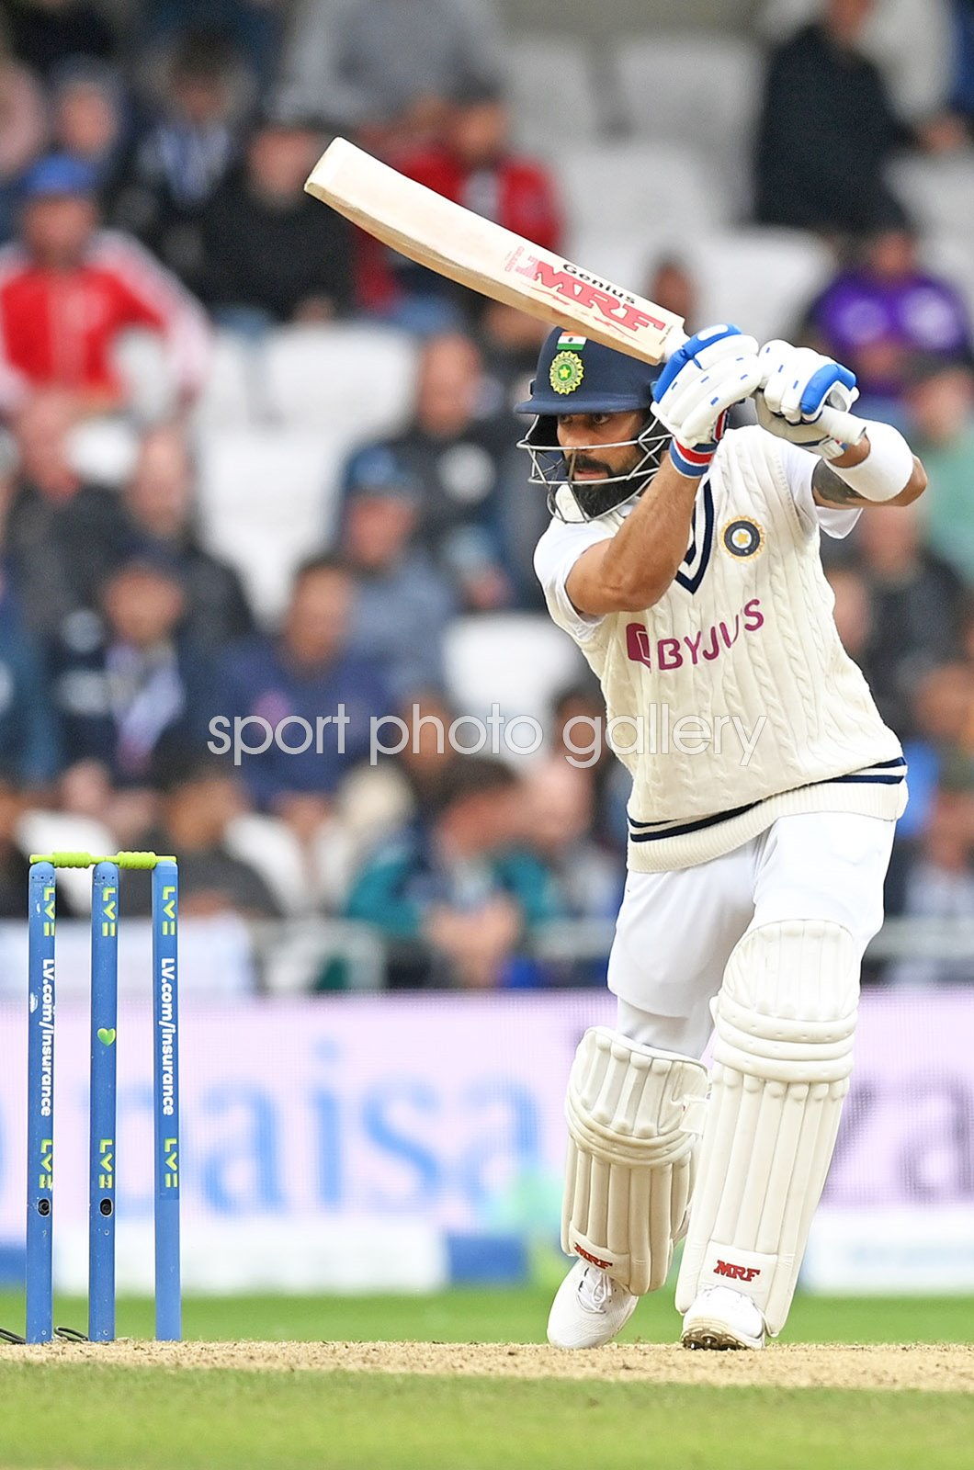
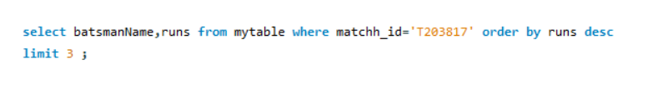
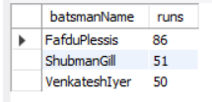


Scorers in a Match
List the top 3 highest-scoring batsmen for a given match
along with their runs.
Definition:
This query fetches the batsmanName and runs from mytable where the matchh_id matches 'T203817’,orders the results by runs in descending order, and limits the output to the top 3 rows.
Output:
0 1

Slide 5

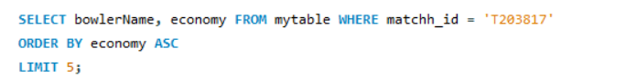
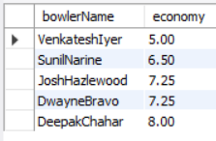
Best Economy Rates
Find the top 5 bowlers with the best economy rates in
a given season.
Definition:
Output:
The SQL query selects the bowlerName and economy columns from the table mytable where the matchh_id equals 'T203817'. It orders the results by economy in ascending order and limits the output to the top 5 rows.
0 2

Slide 6

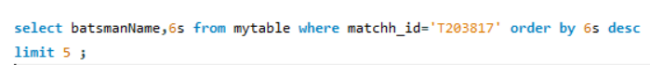
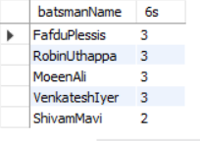
Most Sixes in a Match
Identify the batsman who hit the most sixes in a particular
match.
Output:
Definition :
This query selects the names of batsmen (batsmanName) and the number of sixes they hit (6s) from mytable for a specific match (matchh_id='T203817'). The results are ordered by the number of sixes in descending order and limited to the top 5 batsmen
0 3

Slide 7

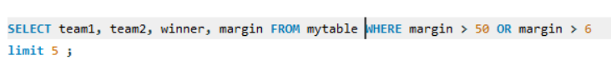
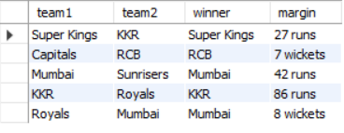
Match Winners by Margin
List 5 matches where the winning team won by a margin of more than 50 runs or 6 wickets.
Definition :
Output:
The SQL query selects the columns team1, team2, winner, and margin from the table mytable where the margin is greater than 50 or greater than 6, returning up to 5 rows.
0 4

Slide 8

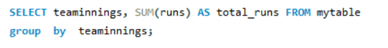
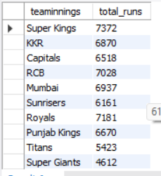
Team's Total Runs in a Match
Calculate the total runs scored by each team
in a specific match.
Definition :
Output:
The SELECT statement retrieves the
teaminnings and the total runs for each team
from mytable. TheSUM(runs) calculates the total
runs scored by a team in all innings. The GROUP BY teaminnings groups the data by each team's innings to generate the summed runs for each distinct group
0 5

Slide 9

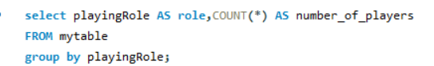
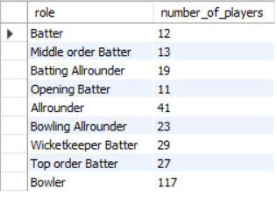
Players' Roles Distribution
Count the number of players in each playing role (batsman, bowler,
all-rounder, etc.) in the tournament.
Definition :
Output :
This SQL query retrieves the count of players grouped by their roles from the table mytable. It selects the column playingRole as role, and counts how many players have each role, displaying the result as number_of_players. The GROUP BY clause ensures the results are categorized by each unique playing role.
0 6

Slide 10

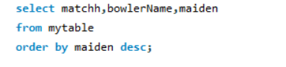
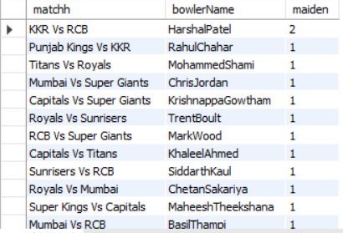
Maiden Overs by Bowlers
List the bowlers who have bowled maiden overs in a specific match and how many they bowled.
Output :
Definition :
This SQL query selects the columns matchh, bowlerName, and maiden from the table mytable. The results are ordered in descending order based on the values in the maiden column. This allows retrieving bowlers with the highest number of maiden overs first.
0 7

Slide 11
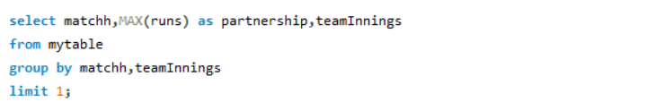
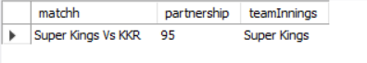
Top Partnerships
Determine the highest batting partnership for a particular team in a specific match.
Definition :
Output :
This SQL query selects the highest partnership (maximum runs) for each match and team innings from the mytable table. It groups the results by matchh and teamInnings, showing only the highest partnership for the top result due to the LIMIT 1.
0 8

Slide 12
CONCEPTS
WHERE clause is used to filter records from a result set based on specific conditions. It allows you to retrieve only the data that meets your criteria, making your queries more precise and efficient.
ORDER BY clause is used to sort the result set of a SELECT statement in ascending or descending order based on one or more columns.
JOIN combines rows from two or more tables based on a related column between them. It allows you to retrieve data from multiple tables simultaneously, creating a new result set with columns from both tables.
subquery is a query nested within another query. It's used to retrieve data that is then used in the main query's WHERE, HAVING, or FROM clause. Subqueries allow for complex data manipulation and filtering.
LIMIT clause restricts the number of rows returned by a SELECT query. It's often used for pagination, fetching specific numbers of records, or improving query performance on large datasets

Slide 13
THANK YOU

